Slide 1
VG101Jigang RC1
Wang Kaibin

Slide 2
Basics about computer
CPU —— The core of command and computation
Powered by central clock and works in certain frequency, processing limiting number of command in a period.
CPU can only understand machine language, which can uniquely mapped to assembly language.
Modern languages are transformed to machine language or interpreted by some other programs so that CPU could execute it.

Slide 3
BASICS ABOUT COMPUTER
Compilation and Interpretation
Compilation means to translate high-level language into assembly language, and further transformed into machine code.
Example: C/C++, Delphi
Interpretation means to execute the program directly using another software, without translating the language to another language.
Example: Matlab, Python

Slide 4
Basics about computer
Storage materials, RAM and ROM
RAM —— Random Access Memory, or memory.
Our variables are stored in RAM section, it’s fast but could lose data without power supply.
ROM —— Read Only Memory.
Often-used ROM is Hard Disk, it’s slow but stable. Programs and files are stored in this part of storage system.
The last phrase of file name after ‘.’ Is called extension, it often represents the type of this file.

Slide 5
MATHEMATICS ABOUT COMPUTER
Logical mathematics and Binary data
Basic logical unit in the system is True and False, or 0 and 1. It can be easily expressed by digital circuit (VE270).
By putting multiple logical numbers together, we could represent any number in BINARY form.
ALL DATA in computer is stored in binary form, including text files and programs.

Slide 6
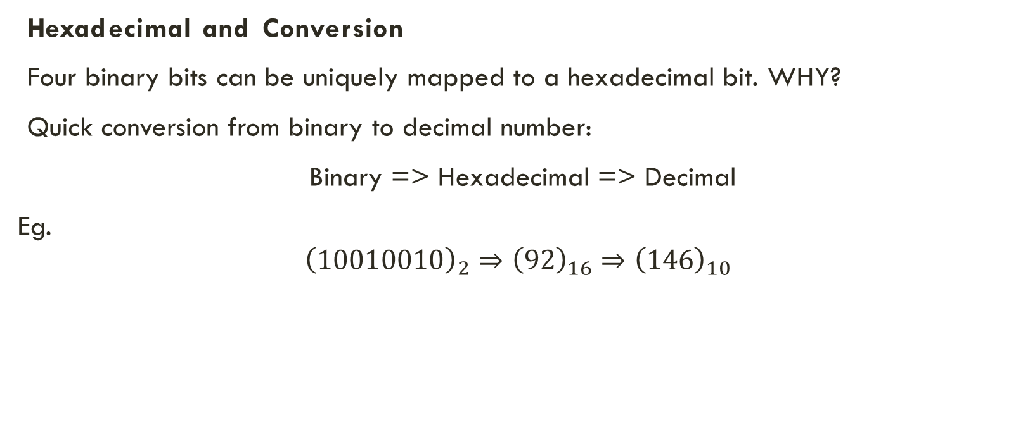
MATHEMATICS ABOUT Computer
Hexadecimal and Conversion
Four binary bits can be uniquely mapped to a hexadecimal bit. WHY?
Quick conversion from binary to decimal number:
Binary => Hexadecimal => Decimal
Eg.
$${\left(10010010\right)}_{2}⇒{\left(92\right)}_{16}⇒{\left(146\right)}_{10}$$

Slide 7
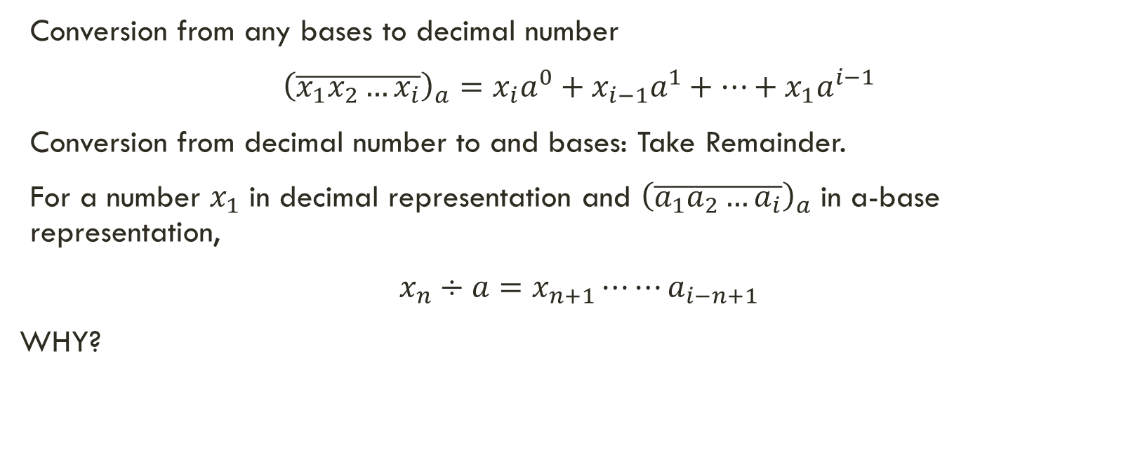
MATHEMATICS ABOUT COMPUTER
Conversion from any bases to decimal number
${\left(\overline{x_{1}x_{2}…x_{i}}\right)}_{a}=x_{i}a^{0}+x_{i−1}a^{1}+…+x_{1}a^{i−1}$
Conversion from decimal number to and bases: Take Remainder.
For a number $x_{1}$ in decimal representation and ${\left(\overline{a_{1}a_{2}…a_{i}}\right)}_{a}$ in a-base representation,
$x_{n}÷a=x_{n+1}⋯⋯a_{i−n+1}$
WHY?

Slide 8
BASICS ABOUT MATLAB
Matlab Is:
An interpreting programming language.
A powerful calculator
Multi-functional simulator to many disciplines
Matlab is based on:
Matrix core written by C language
Standard library by Matlab language
Countless Add-ons

Slide 9
BASICS ABOUT MATLAB
Interactive Command Window:
Execute Matlab language in the form of command
Give the answer interactively
Useful when doing simple calculations
Editor Window:
Write Matlab code in text files before executing
Can both execute directly or be called as function
Code reuse and structuralizing

Slide 10
BASICS ABOUT MATLAB
Variable and Variable type
In Matlab, variables would be created if we use assignment statement for this variable. It will allocate a space in RAM and specify its type in Matlab program.
Basic variable types are divided into matrix and none-matrix variable in Matlab. All numbers, characters and their array are regarded as matrix.
E.g. a = 1; Creates a 1x1 numeric matrix and put an 1 into it.\

Slide 11
BASICS ABOUT MATAB
Variable and variable type
Numeric: bool, integer, floating point
Bool: single bit number ----------- 0 and 1
Integer: int(x) ------- x bit integer eg. Int32 is signed 32-bit integer
01010101 11111111 01010101 11111111
55FF55FF
Exercise: What’s the smallest number that a signed 16-bit integer can represent?
**Unisigned 8-bit integer uint8: A basic memory piece, a byte. *Equal to character*
Sign Bit

Slide 12
BASICS ABOUT MATLAB
Variable and variable type
Numeric: bool, integer, floating point
Floating point Number: single (32-bit) and double (64-bit)
Matlab preferred numeric type: double (Used for calculation) and uint8 (Used for storage).
Cast: convert a type to another. May lose accuracy!
Compare: vpa, roundn.

Slide 13
BASICS ABOUT MATLAB
Variable and variable type
Character and string
Char: a single character, stored in computer by ASCII code. *Equal to uint8
‘string’: Character array/matrix.
*Operation of ‘string’ like a matrix: [‘Hello’ ‘ ‘ ‘World’ ‘!’] => ‘Hello World!’
*Operation of ‘string’ like an integer: char(‘abc’ – 32) => ‘ABC’
“String”: A specific string type.
This is possible: a “string” matrix. Why can’t there be a ‘string’ matrix?

Slide 14
BASICS ABOUT MATLAB
Variable and variable type
Composited Type
Cell: hybrid type of array. Can store any type of variable including another cell.
Structure array: structured type of array. Key-value pair. Basic for data structures.
Function handle: represent a function and store it in a variable.
Class function: Check what type the variable is.
E.g. class(“123”) => ‘string’ class(‘123’) => ‘char’

Slide 15
BASICS ABOUT MATLAB
Statements
A Matlab statement is ended by a line change, a comma, or a semicolon. Semicolon prevents output, which is different from other two.
The mostly used end of a statement is semicolon.
Basic statement in Matlab includes assignment, operation, condition and loop.
Assignment: a = operation; It will create a if a doesn’t exist.
Operation: +,-,*,/,\,^ A ‘.’ is added to operate element-wise to a matrix
Condition: if/switch
Loop: for, while What’s the advantage for each one?

Slide 16
BASICS ABOUT MATLAB
Matrix Operation
High efficiency operation to multiple variables.
Compare: for loop and matrix addition.
How to convert?
Element-wise operation
Matrix as index
Matrix as argument
Matrix-based functions
Example: Find primes under number x (A problem in 2018 lab1).

Slide 17
BASICS ABOUT MATLAB
Function and call
Function is the basis of process-oriented language (such as Matlab). A function may take arguments and return values.
function RETURNS = NAME(ARGUMENTS)
Example:
function [BMI, status] = ComputeBMI(weight_kg, height_cm)

Slide 18
BASICS ABOUT MATLAB
Function and working directory
Call function in different files: call by file name.
Entrance point: file name as the main function.
Organize your project
Example of Manuel’s Project 1.

Slide 19
CONSTRUCT YOUR PROGRAM
Coding Format
Indentation
Good spacing
Split of logical sections
Naming convention
Readability
Algorithm and Data structure
Speed and space
Reconstruction and improvement

Slide 20
CONSTRUCT YOUR PROGRAM
Libraries
Standard libraries
Create one’s own library
Code reuse

Slide 21
BASIC ALGORITHM - NUMBERS
Algorithm with number theory
Separate a digit of a number
Count the digit of a number
Find divisors / find divisor-sum number
Algorithm with strings and matrices
Convert a number to string
Arbitrary base conversion
Reverse of a number
Reverse of an array

Slide 22
ANY QUESTIONS? OH will be started soon at LBL 326G

